Slide 1
Reversing the Oura Ring App
Simon Pickert
16.11.2025

Slide 2
Reversing the Oura Ring App
Goal
  Interoperability: Independent App to communicate with the Ring
Planned Steps
  1. Find hooks to sniff on Bluetooth (BLE) communication and find commands to read data from the device e.g. heartbeat
  2. Decode further commands to read more data like sleep tracking metrics
  3. Try to run independent app that communicates with the ring i.e. handshakes
    bypass app level BLE security if existent
Basic Setup:
  Rooted Android phone: Xiomi Poco 3 via miflash unlock
  Frida Gadget on the same phone

Slide 3

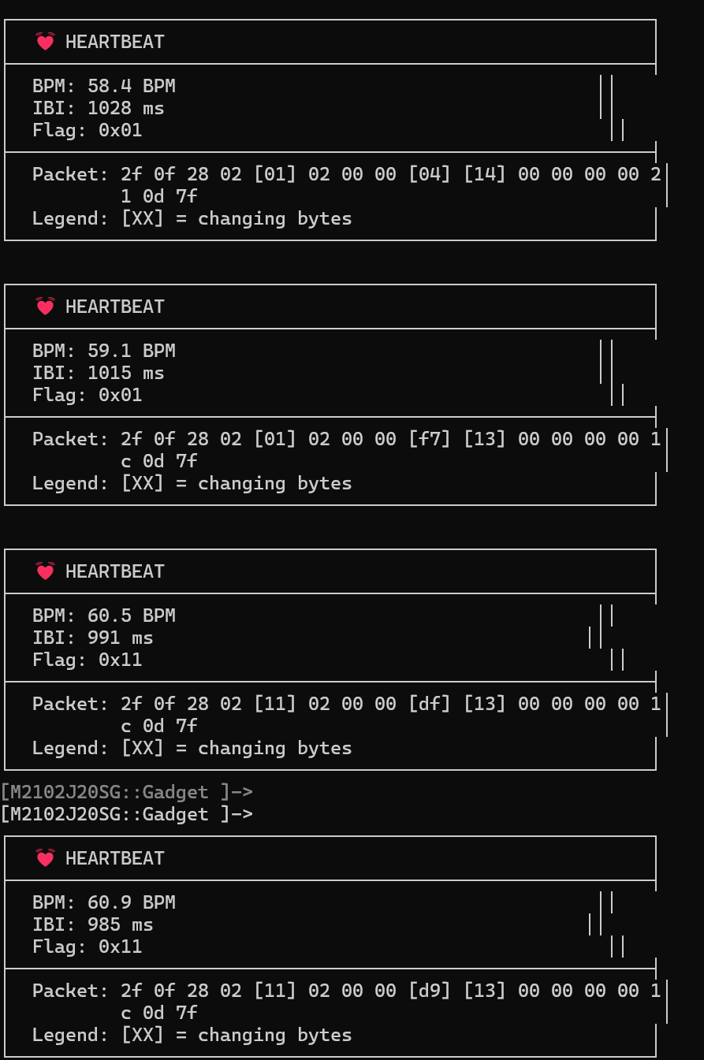
Frida Hook the Heartbeat
Click on heart icon on phone starts “live heartbeat” mode
  We see BLE write command in trace followed by BLE notifications
How we got there?
Decompiled Java app showed Oura app partially uses third-party SweetBlue BLE library instead of standard Android Bluetooth APIs
To capture heartbeat, the solution is to overwrite low level Bluetooth notifications
  Found handler in SweetBlue classes to hook characteristic notification
  filter on UUID for the heartbeat characteristic
We use a Frida gadget to overwrite handler and capture heartbeat
  frida -U Gadget –l simple-heartbeat-monitor.js
Payload carries IBI in Byte 8 and 9
  Contains IBI = Inter-Beat Interval
  BPM = 60000 / IBI
Outlook / next steps:
  Understand bonding of the ring (authentication) for independent app use
  Understand full Oura protocol details for commands and notifications
    Read arbitrary data e.g. sleep, physician activity etc.
  Own app to pair the ring and to read data

Slide 4
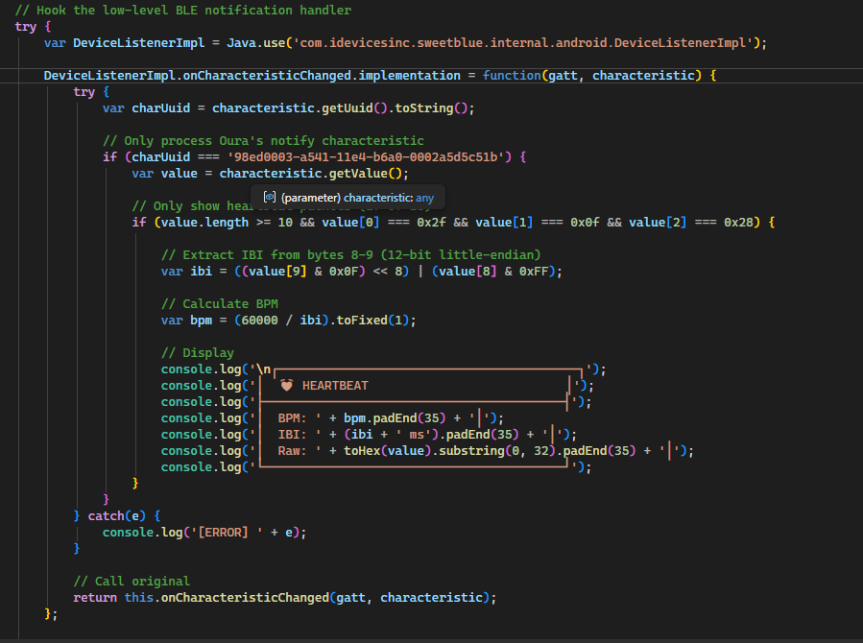
Oura App Heartbeat Frida Hook simple-heartbeat-monitor.js

Slide 5
Reversing Engineering the Oura Ring App part 2
Simon Pickert
19.11.2025

Slide 6
Recap
What we learned so far:
how we can frida hook the oura app with a gadget
how to listen to the heartbeat notifications in Oura app ​
Main Questions:​
How to communicate with the ring without the Oura app?​
Read data e.g. sleep metrics? What about all other data?​
How to send commands to the ring? Which commands exist?

Slide 7
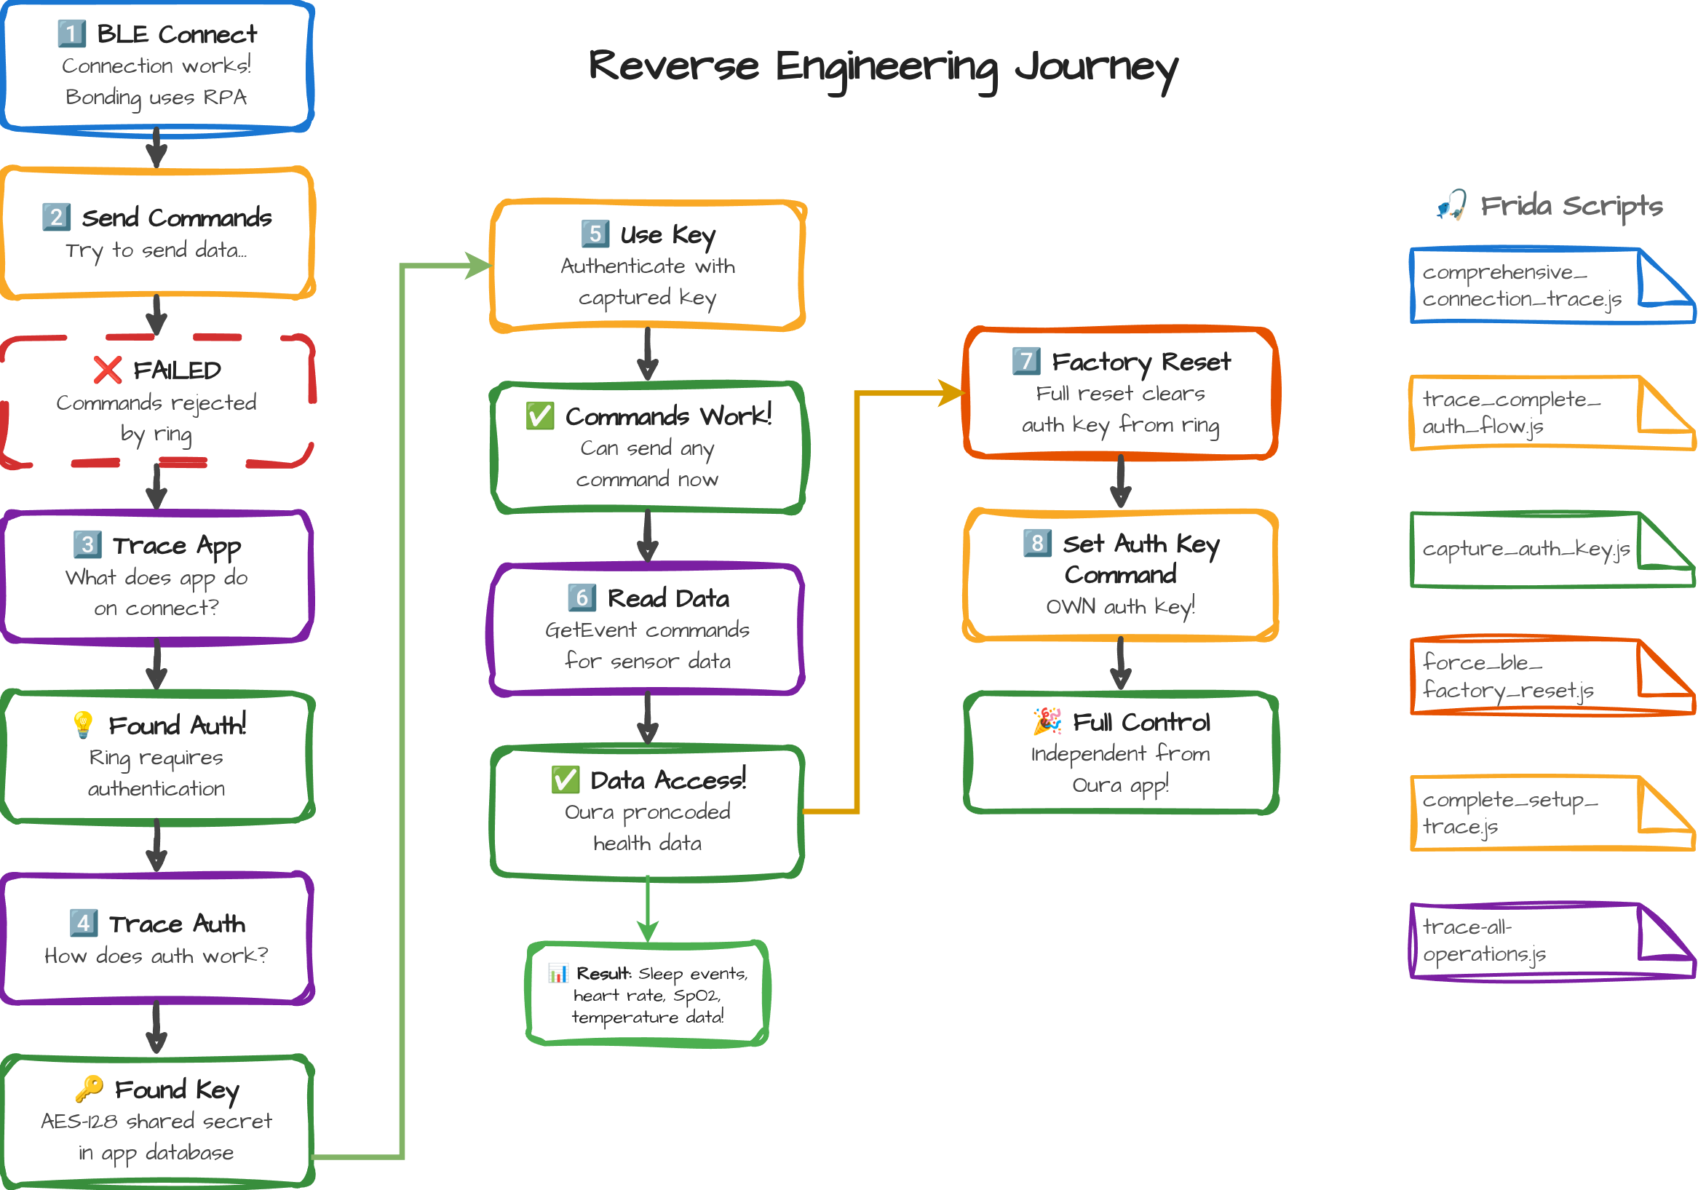

Slide 8
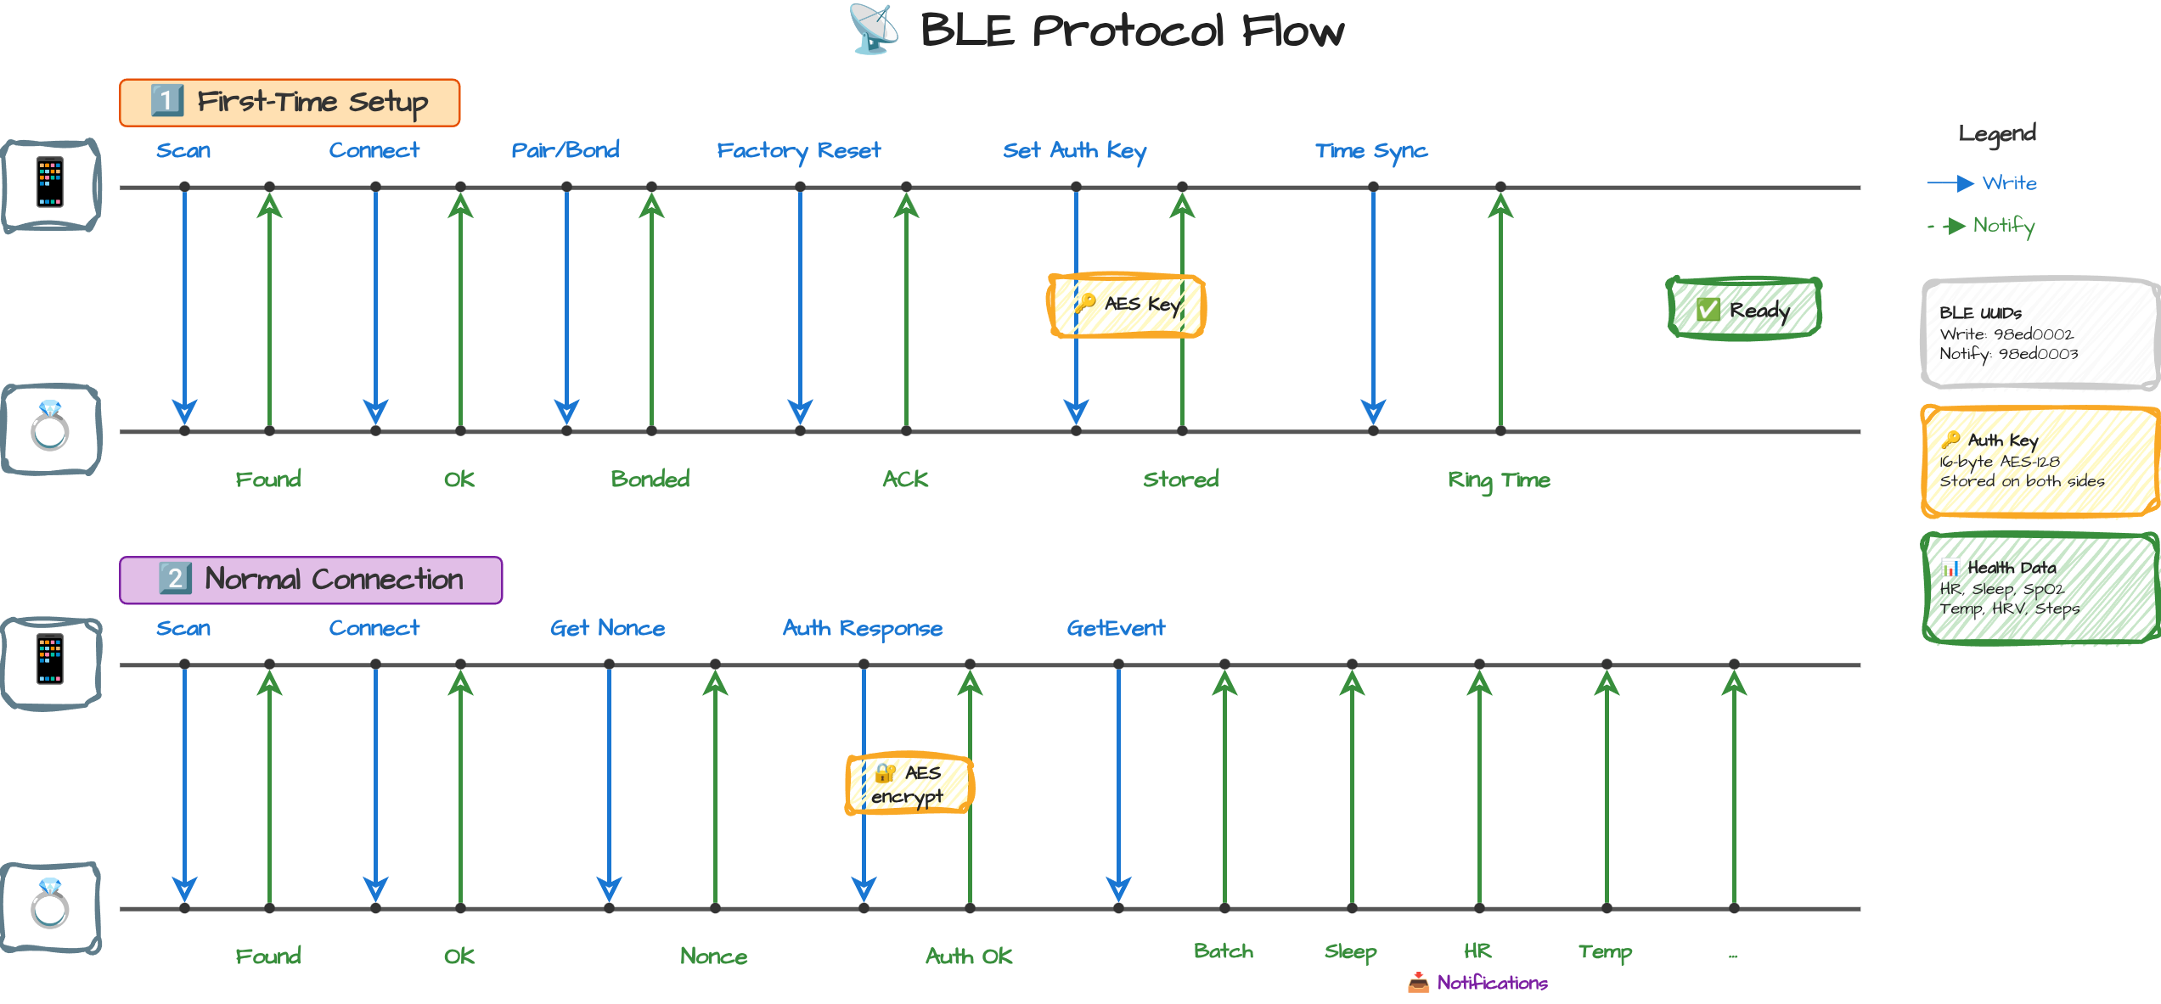

Slide 9
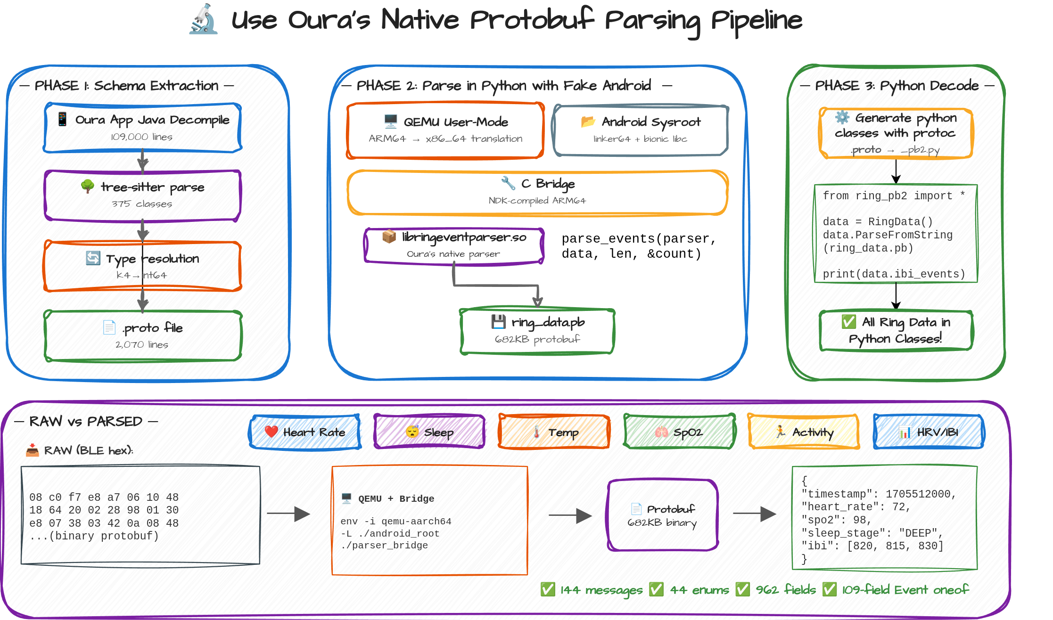

Slide 10
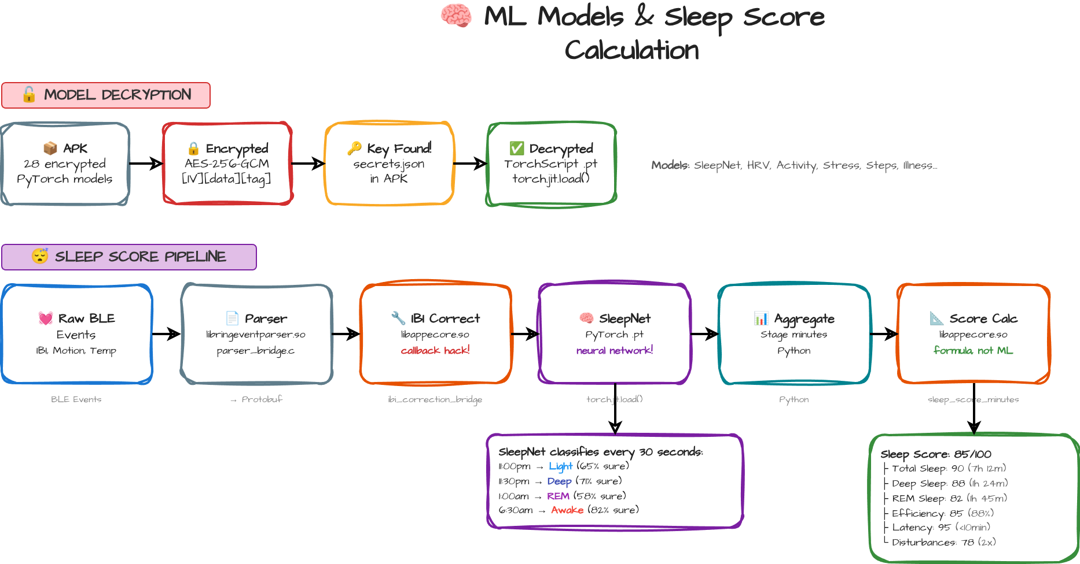

Slide 11
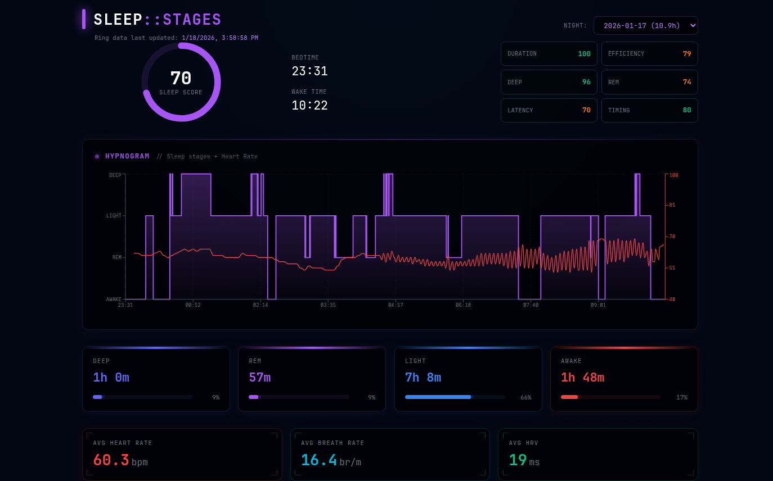

Slide 12
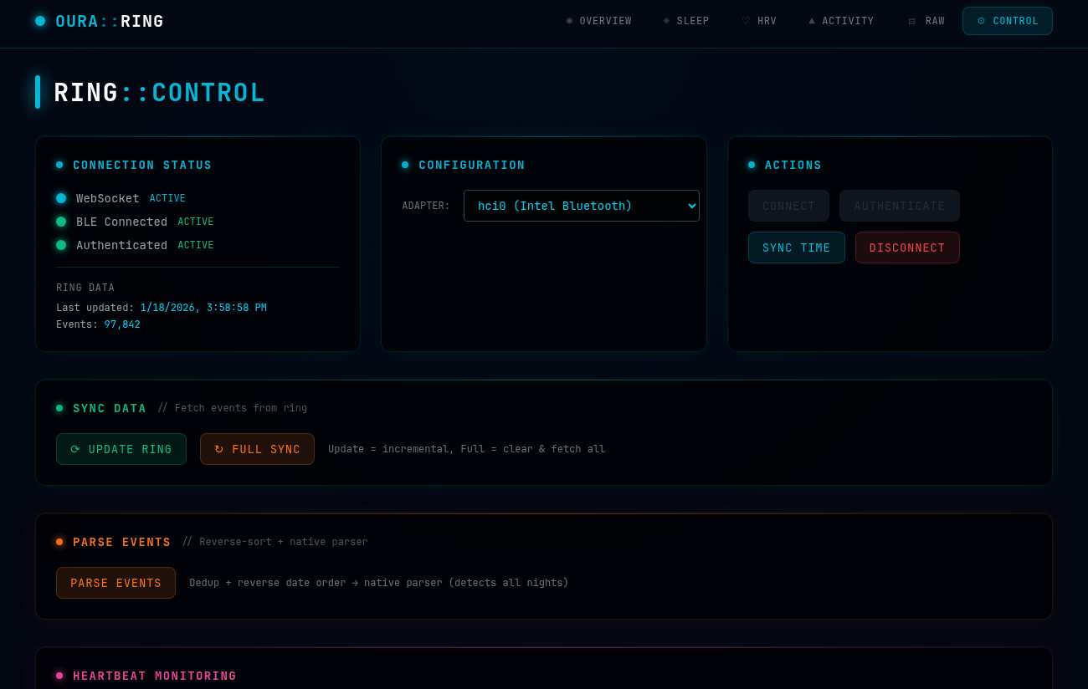
DEMO

Slide 13
Challenges / Todos left
Add more useful sensor event outputs (Readiness Score based on all metrics)
  Complicates requires multiple so files
Make own app work in parallel to real Oura app (Oura app detects changed auth key, bans unsigned apks)
  Patch oura apk to bypass restrictions and allow setting auth key
Improve pairing/bonding to work on different machines (there are some tricks for that)
Improve portability, Docker for parsing in QEMU etc.

